Slide 1
Computer Security Principles
COMP6824001
Understanding Common Attack Methods & Policies
Session 6

Slide 2
These slides have been adapted from:
Panek, Crystal. (2019). Security Fundamental, John Wiley & Sons, Inc. Indianapolis. ISBN: 978-1-119-65066-9
Lesson 3
Acknowledgement

Slide 3
Learning Objectives
LO1: To explain the security principles, threats, attacks and security strategy
LO2: To evaluate different strategies to handle security threats and attacks
LO3: To apply different techniques in handling computer and network security

Slide 4
Topics
Understanding Common Attack Methods
Dictionary Attack/Brute Force Attack
Physical Attack
Leaked or Shared Passwords
Cracked Password
Network/Wireless Sniffer
Guessed Passwords
Protecting Domain User Account Passwords

Slide 5
Understanding Common Attack Methods

Slide 6
Understanding Common
Attack Methods
Passwords have long been recognized as one of the weak links in many security programs.
Passwords are considered a weak link for two main reasons:
  Users select their own passwords
  Strong passwords are vulnerable to attack through a variety of different mechanisms

Slide 7
Understanding Common
Attack Methods
Dictionary Attack
Leaked or Shared Passwords
Cracked Passwords
Network/Wireless Sniffer
Guessed Passwords
Physical Attack

Slide 8
Dictionary Attack
A dictionary attack is a brute force attack technique uses a dictionary containing an extensive list of potential passwords that the attacker then tries in conjunction with a user ID to attempt to guess the correct password
Custom dictionaries with likely passwords are available for download from the internet, commonly used as passwords.
Attacks tend to be more successful when the password length is 7 characters or less
Users will sometimes use common words with the first letter capitalized and then append a number to meet the complexity guidelines.

Slide 9
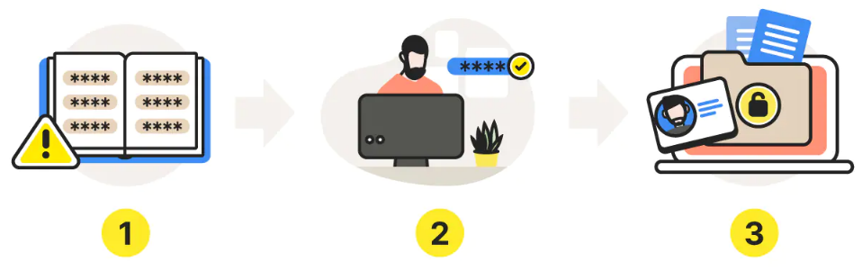
Dictionary Attack
Hacker creates dictionary from common words and phrases
Automated dictionary attack tools use the password dictionary to hack accunts.
Hacker steals and/or exposes the sensitive data stored on your profile
https://us.norton.com/blog/emerging-threats/dictionary-attack
Notes:
https://us.norton.com/blog/emerging-threats/dictionary-attack

Slide 10
Physical Attack
Physical attacks on a computer can completely bypass almost all security mechanisms
  Capturing the passwords & critical data directly from the keyboard when a software or hardware keylogger is used.
  The use of a hidden camera to tape keystrokes, or even the removal and duplication (or direct theft) of a hard drive.
  Attackers can frequently bypass password controls by mounting the drive remotely, and accessing data directly from the drive, without an intervening operating system.

Slide 11
Leaked or Shared Passwords
Another challenge that is commonly encountered when dealing with users in an office environment is the leaked or shared password.
A user could easily be convinced to share their password with a co-worker who felt they “needed it.”
User awareness is the best way to combat this type of attack.

Slide 12
Cracked Password
The attacker gets access to an encrypted password file from a workstation or server
The attacker will start running password cracking tools against the file
Towards breaking as many passwords as possible, then leveraging them to further compromise the company’s network and systems

Slide 13
Network/Wireless Sniffer
Sniffers are specially designed software (and in some cases hardware) applications that capture network packets as they traverse the network and display them for the attacker.
Sniffers are valid forms of test equipment, used to identify network and application issues, but the technology was rapidly co-opted by attackers as an easy way to grab logon credentials.

Slide 14
Guessed Passwords
There is still the possibility that someone could sit down at your computer and guess the password
The attacker is familiar with the person whose system they are trying to compromise
They look around the office and see a postcard from a trip, or pictures of the kids with their names on them to ascertain the password

Slide 15
Protecting Domain User Account Passwords
Malware has changed dramatically and has become quite sophisticated.
Device Guard helps harden a computer system against malware by running only trusted applications.
Install Hyper-V and Isolated User Mode on Windows 10
Enable Device Guard and Credential Guard

Slide 16
Question ?

Slide 17
References
Panek, Crystal. (2019). Security Fundamental, John Wiley & Sons, Inc. Indianapolis. ISBN: 978-1-119-65066-9
https://us.norton.com/blog/emerging-threats/dictionary-attack

